Slide 1
eCommerce

Slide 2
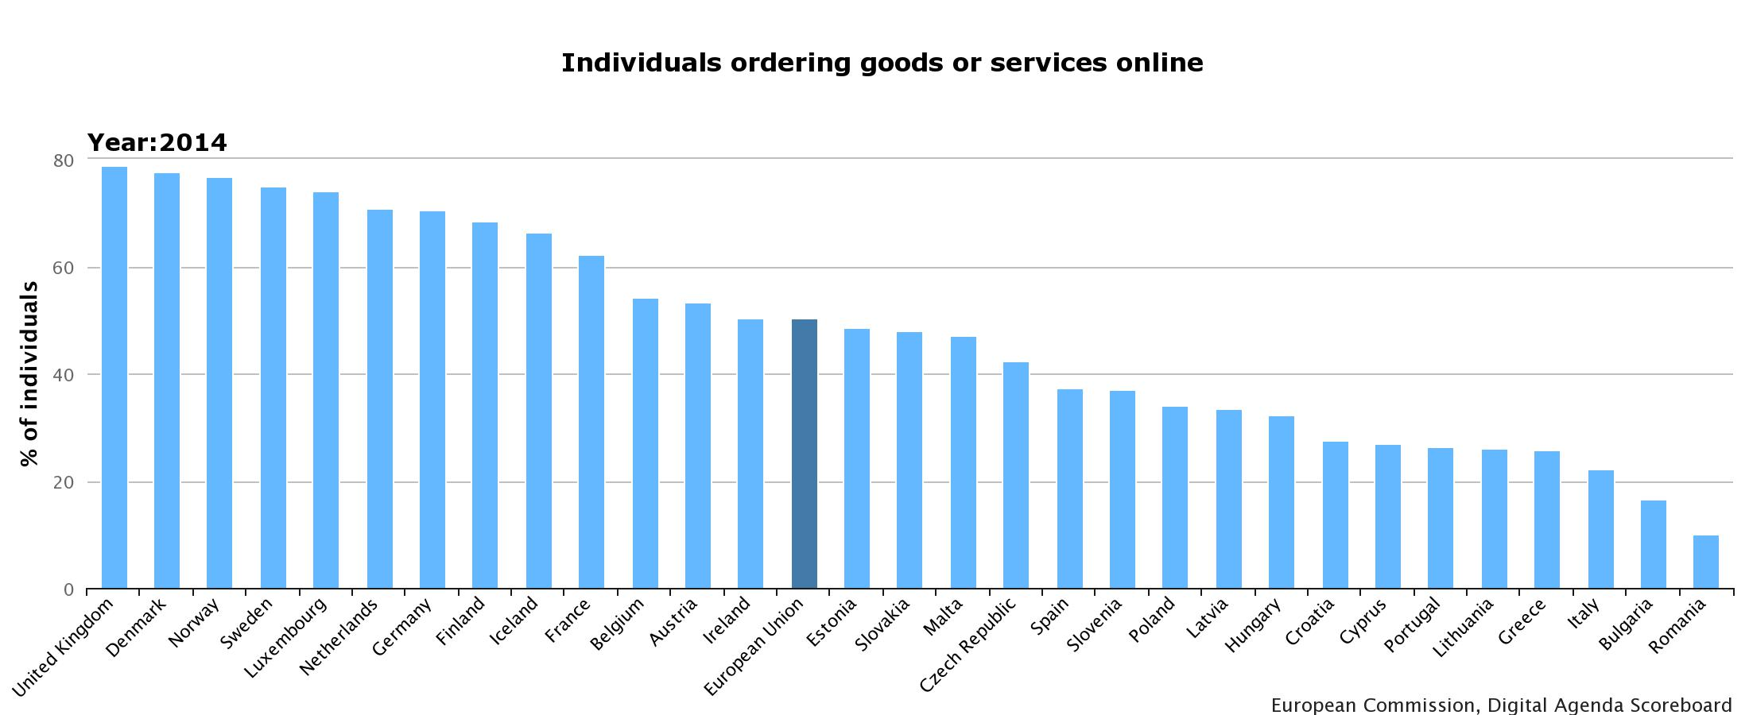
eCommerce by citizens
Online shopping has made continuous progress, up more than 14 percentage points to 50% of citizens. advancing in a close parallel with Internet use. There is no clear connection on member state level between level achieved and further progress, with only the Netherlands, Italy and Romania adding less than 10 percentage points. At the other end, Slovakia is the only country to increase by more than 20 percentage points.

Slide 3
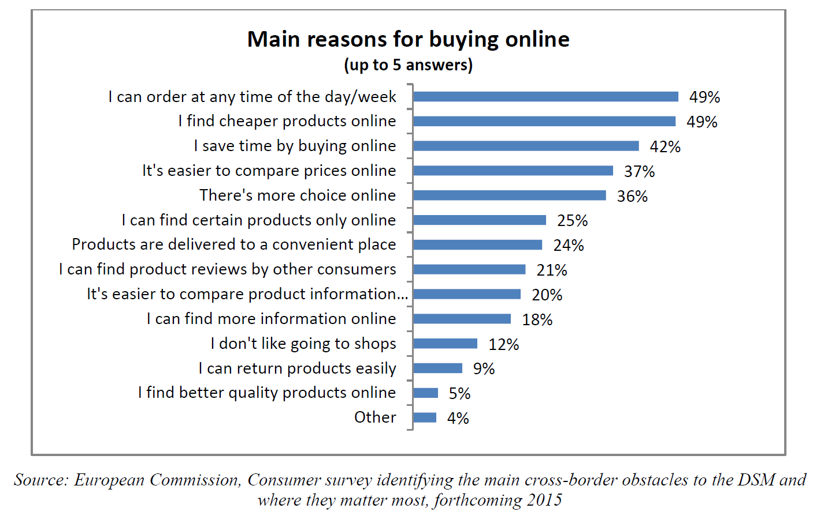
Reasons for shopping online
Convenience, variety and prices are the main drivers for the adoption of eCommerce by citizens. On the other hand, data protection and payment security (30% of respondents were concerned that personal data may be misused and 25% that payment card details may be stolen) are the most important concerns of online shoppers.

Slide 4
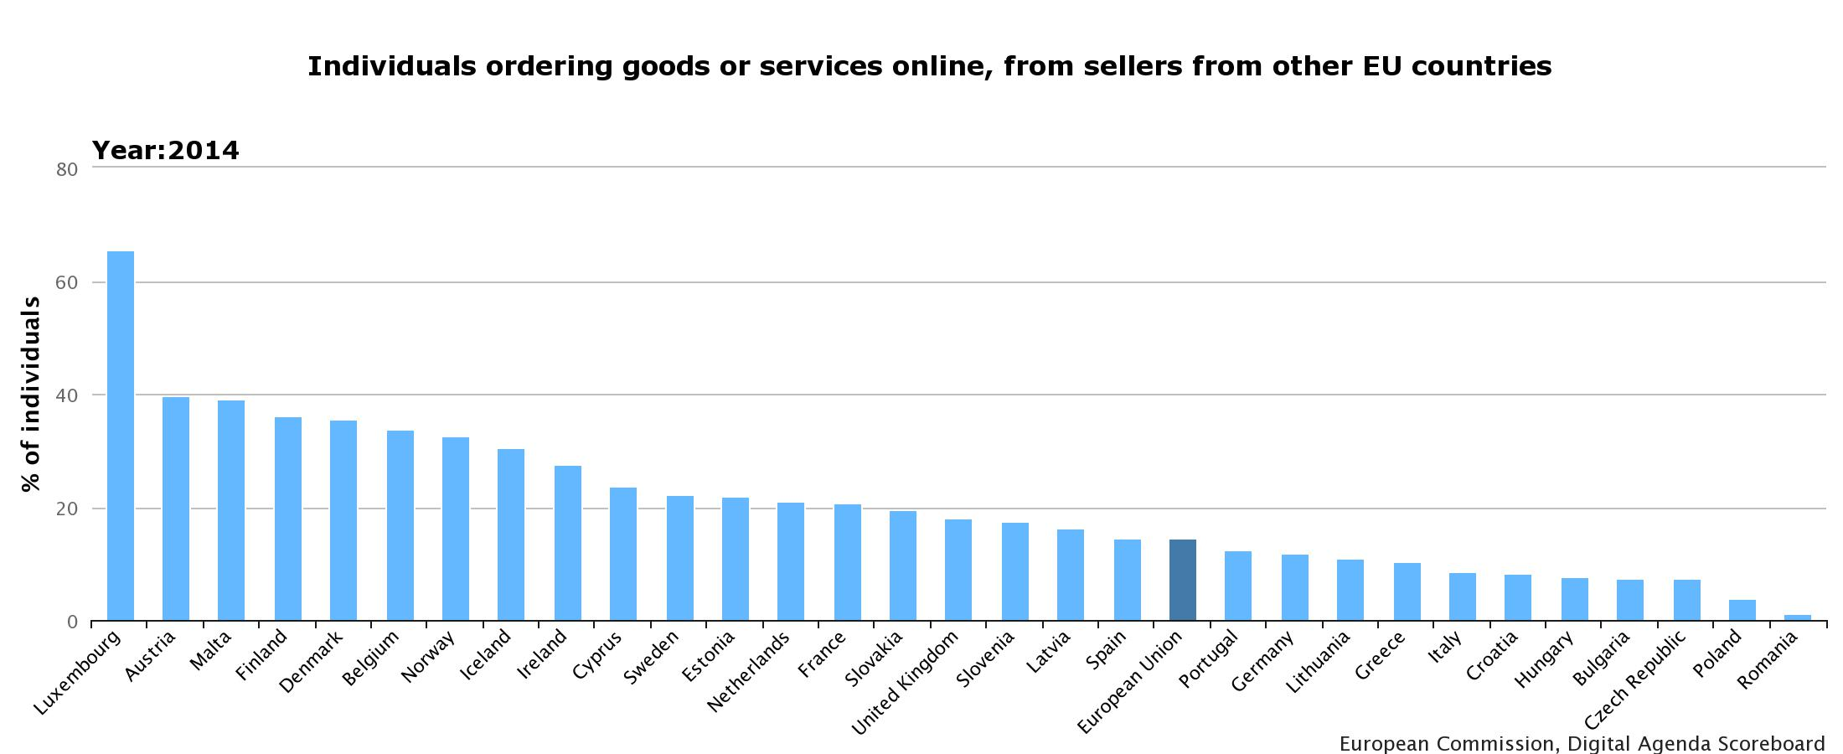
Cross-border eCommerce by citizens
While 44% of citizens shop online nationally, only 15% cross a border to another Member State when doing so (9% do both, while 6% buy only from abroad, mostly in smaller Member States with a less developed offer). Cross-border online shopping is advancing regularly, adding six and a half percentage points in four years to reach nearly 15% in 2014. Smaller member states do not only have higher levels of cross-border shopping, but display also higher growth.

Slide 5
Concerns when shopping online cross-border
Consumer's main concerns with cross-border shopping relate to delivery in terms of cost and time, followed by solving problems in case of products which are not up to expectations.
Source: European Commission, Consumer survey identifying the main cross-border obstacles to the DSM and where they matter most, forthcoming 2015

Slide 6
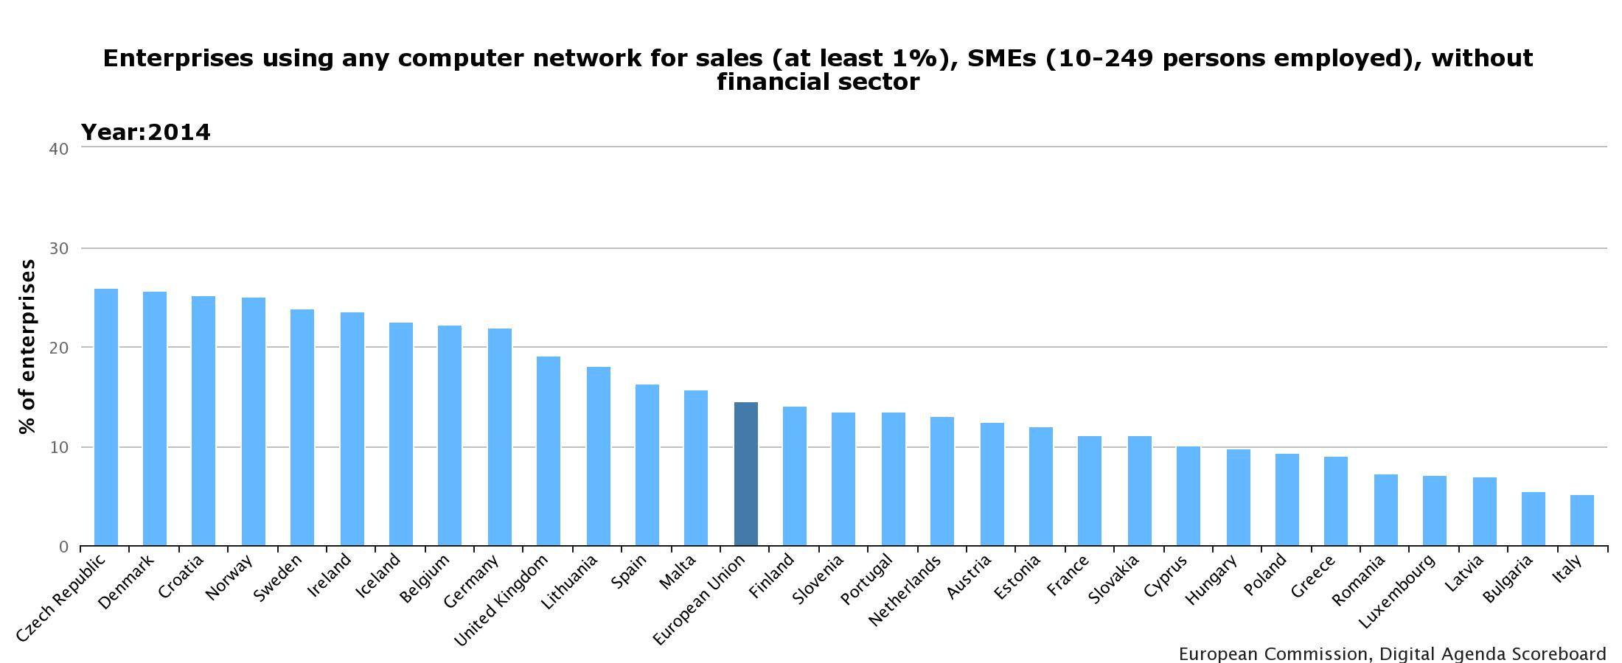
eCommerce by companies
European SMEs continue to miss out on the opportunities of online sales. Only 14.5% of them sell online, which represents an increase of only 3.5 percentage points over five years. is growing at a glacial pace, reaching 14% in 2013, compared to a DAE baseline of 12%. Interestingly, the best performing countries include the Czech Republic and Croatia. Even the best performing countries are far from the EU-wide target of 33% by 2015 . Large companies, on the other hand, are much more active, with 35% of them selling online. This represents a gain of 6 percentage points over the last five years. Thus the gap between SMEs and large companies has increased since the Digital Agenda was launched.

Slide 7
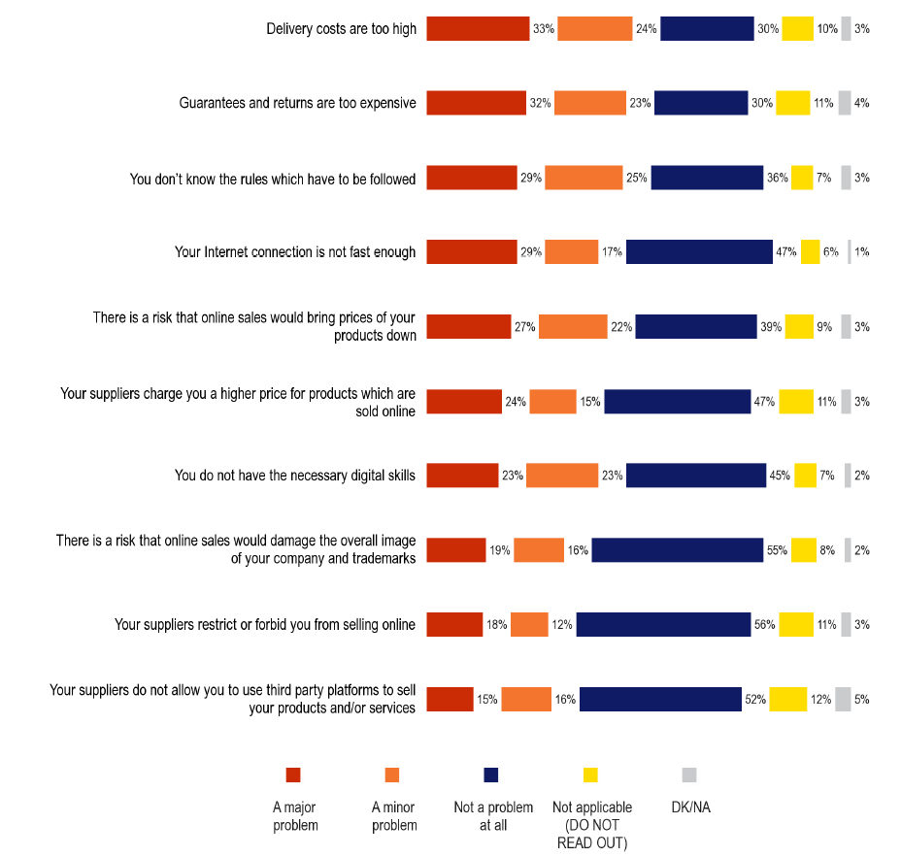
Barriers to selling online
For companies who are not selling online, the delivery system is overwhelmingly the most important concern, either via direct shipping costs or via the cost of guarantees and returns, although uncertainty about the applicable law follows a close third.
In general, SMEs are more concerned about most of the barriers than large firms, and micro enterprises more than SMEs. Selling online requires an up-front investment (in terms of money but also in terms of time, e.g. to research legislation) which larger companies can afford more easily.
Source: Flash Eurobarometer 413 (2015) on Companies engaged in online activities

Slide 8
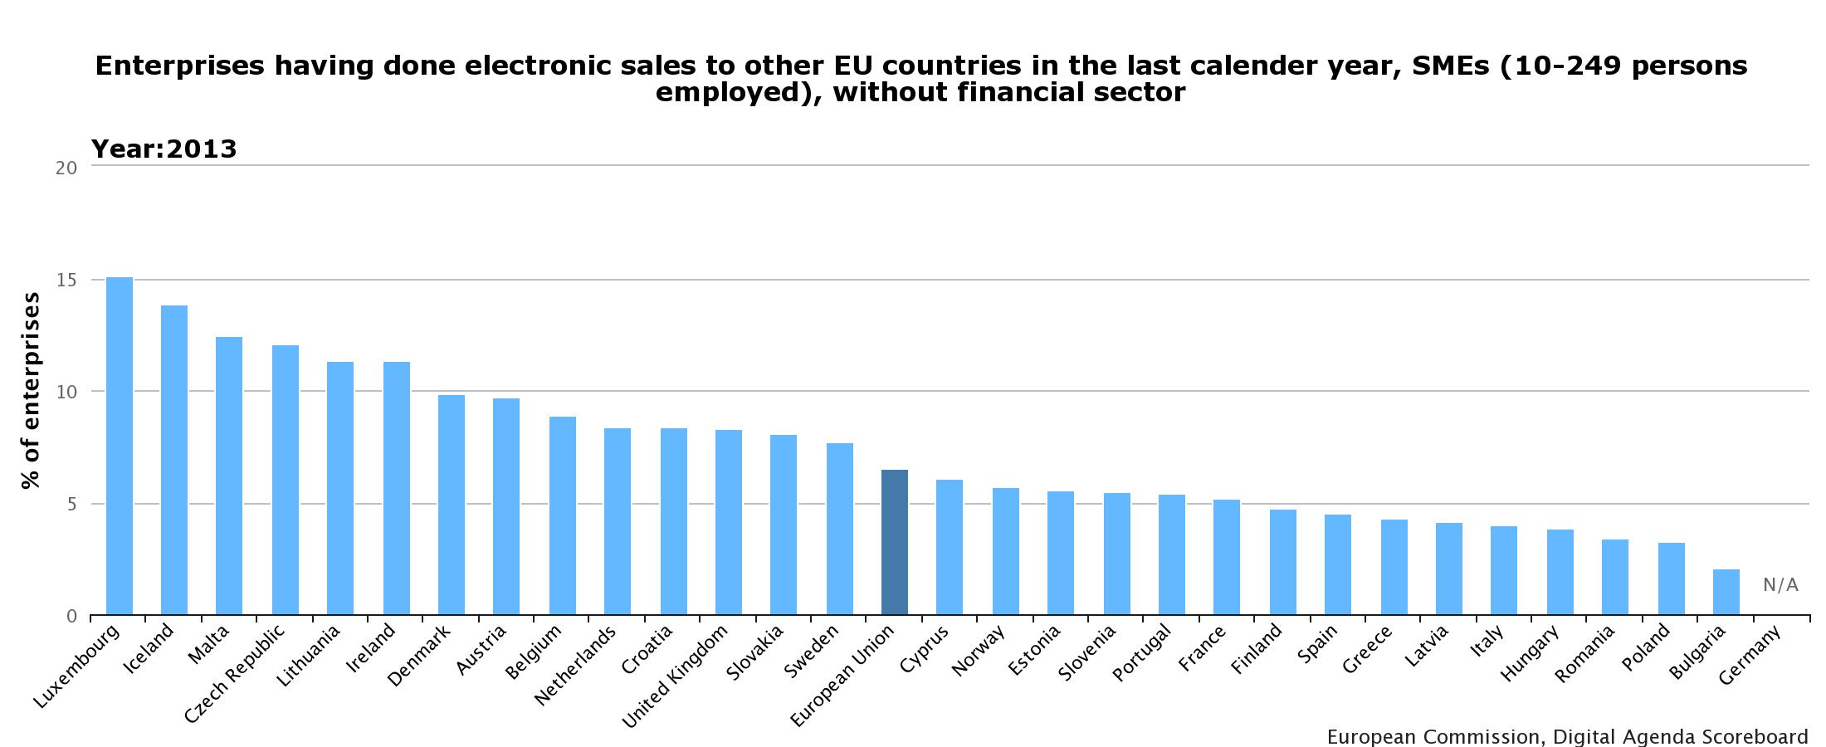
Cross-border eCommerce by companies
Businesses benefit from cross-border e-commerce by exploiting economies of scale which reduce costs, increase efficiency and promote competitiveness, improving total factor productivity . In many cases, without these economies of scale an on-line business may not be viable at all. This could be especially important for SMEs that remain confined to a small home market with high production costs. However, only 7% of European SMEs sell online to other Member states Member states, while 20% of large enterprises do so.

Slide 9
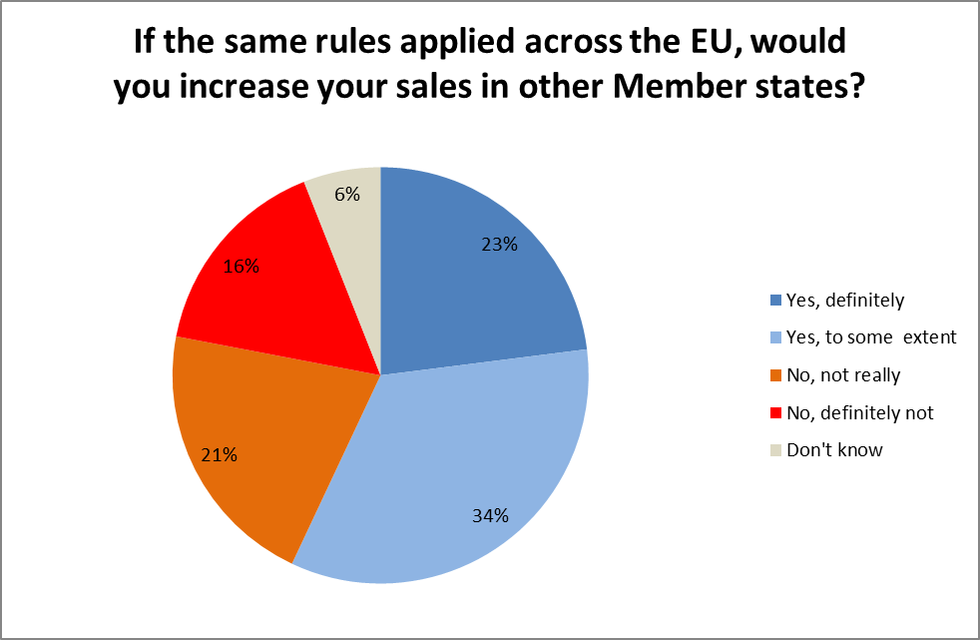
How to get companies to sell cross-border
Online suppliers of goods and services who wish to serve a pan-European market may potentially need to know about, and comply with, 28 differing sets of national regulations. Finding out which regulation applies in which case may be difficult. 37% of EU online exporters to other Member States have problems identifying which rules to follow. That figures rises to 63% for companies trying to start exporting online . This situation creates significant information and compliance costs for many online traders, especially for SMEs, in particular when the value of the transaction remains low.
Base : Companies that sold their products and/or services online in another EU country in 2014 and those that used to do it, tried to do it, are trying to do it or are considering it (N=2423)

